Slide 1
IT 356: Introduction To Computer Graphics (Lecture 26)
School of Information Technology
Illinois State University
Dr. Qi Zhang, Spring 2024

Slide 2
Stencil Testing

Slide 3
Introduction
Once the fragment shader has processed the fragment, a so-called stencil test is executed that, like the depth test, can discard fragments.
The remaining fragments get passed to the depth test, which could discard even more fragments.
The stencil test is based on the content of another buffer called stencil buffer, which we can update during rendering to achieve interesting effects.

Slide 4
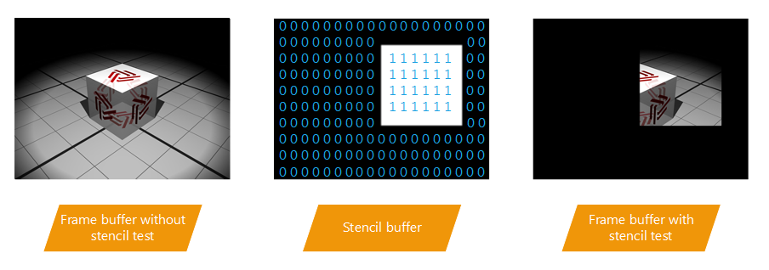
Introduction
A stencil buffer (usually) contains 8 bits per stencil value, which amounts to 256 different stencil values per pixel/fragment.
We can then set these stencil values to values of our liking, and then we can discard or keep fragments whenever a particular fragment has a certain stencil value.

Slide 5
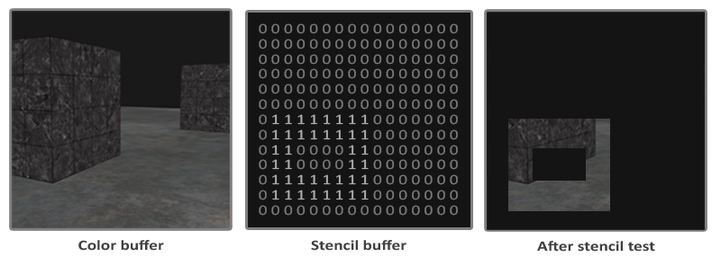
Introduction
Each windowing library needs to set up a stencil buffer. GLFW does this automatically, so we don't have to tell GLFW to create one
A simple example of a stencil buffer is shown below:

Slide 6
Introduction
The stencil buffer is first cleared with zeros, and then an open rectangle of 1s is set in the stencil buffer.
The fragments of the scene are only rendered (the others are discarded) wherever the stencil value of that fragment contains a 1.

Slide 7
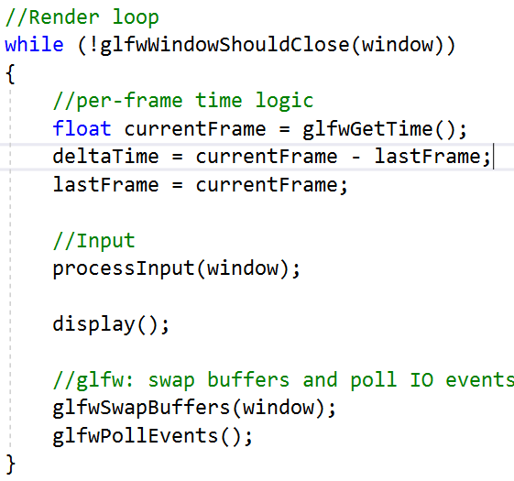
Introduction
Stencil buffer operations allow us to set the stencil buffer at specific values wherever we're rendering fragments.
By changing the content of the stencil buffer while we're rendering, we're writing to the stencil buffer.
In the same (or following) render iteration(s), we can read these values to discard or pass certain fragments.

Slide 8
Introduction
The general outline is usually as follows:
Enable writing to the stencil buffer.
Render objects, updating the content of the stencil buffer.
Disable writing to the stencil buffer.
Render (other) objects, this time discarding certain fragments based on the content of the stencil buffer.

Slide 9
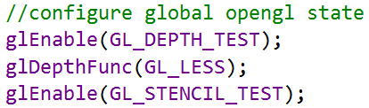
Introduction
By using the stencil buffer, we can discard certain fragments based on the fragments of other drawn objects in the scene.
Can enable stencil testing by enabling GL_STENCIL_TEST.
From that point on, all rendering calls will influence the stencil buffer in one way or another.

Slide 10
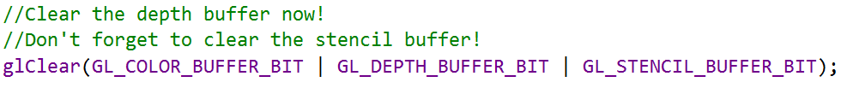
Introduction
Need to clear the stencil buffer each iteration just like the color and depth buffer:
Like the depth testing's glDepthMask function, there is an equivalent function for the stencil buffer.
The function glStencilMask allows us to set a bitmask that is ANDed with the stencil value about to be written to the buffer.
Mask: specifies a bit mask to enable and disable writing of individual bits in the stencil planes. Initially, the mask is all 1's.

Slide 11
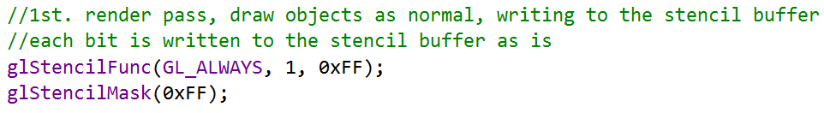
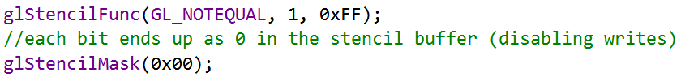
Introduction
By default, this is set to a bitmask of all 1s unaffecting the output
If we were to set this to 0x00 (hexadecimal number), all the stencil values written to the buffer end up as 0s. This is equivalent to depth testing's glDepthMask(GL_FALSE):
0xff is a number represented in the hexadecimal numeral system (base 16). It's composed of two F numbers in hex.
As we know, F in hex is equivalent to 1111 in the binary numeral system. So, 0xff in binary is 11111111
0xff is the hexadecimal number FF which has an integer value of 255
hexadecimal value 0x00 to assign 0 to an integer object

Slide 12
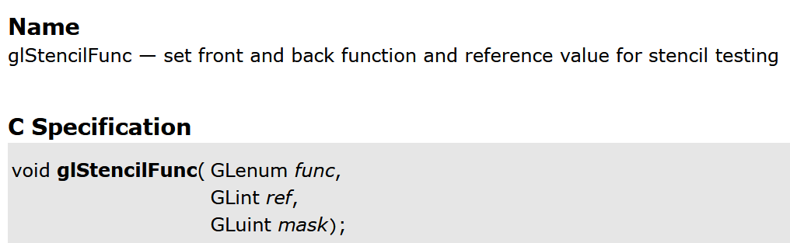
Stencil functions
Just like with depth testing, we have a certain amount of control over when a stencil test should pass or fail and how it should affect the stencil buffer.
There are a total of two functions we can use to configure stencil testing: glStencilFunc and glStencilOp.
https://registry.khronos.org/OpenGL-Refpages/gl4/html/glStencilFunc.xhtml

Slide 13
The glStencilFunc
The glStencilFunc(GLenum func, GLint ref, GLuint mask) has three parameters:
func: sets the stencil test function, which is applied to the stored stencil value and the glStencilFunc's ref value. Possible options: GL_NEVER, GL_LESS, GL_LEQUAL, GL_GREATER, GL_GEQUAL, GL_EQUAL, GL_NOTEQUAL and GL_ALWAYS
ref: specifies the reference value for the stencil test. The stencil buffer's content is compared to this value.
mask: specifies a mask that is ANDed with both the reference value and the stored stencil value before the test compares them. Initially set to all 1s.
https://www.khronos.org/registry/OpenGL-Refpages/gl4/html/glStencilFunc.xhtml

Slide 14
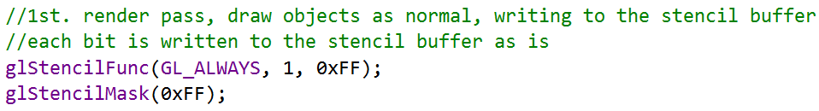
The glStencilFunc
In the case of the simple stencil example, we've shown at the start the function would be set to:
This tells OpenGL that the stencil value of a fragment always (GL_ALWAYS) passes the test
Mask: specifies a bit mask to enable and disable writing of individual bits in the stencil planes. Initially, the mask is all 1's.
https://registry.khronos.org/OpenGL-Refpages/es2.0/xhtml/glStencilMask.xml

Slide 15
The glStencilOp
glStencilFunc described what OpenGL should do with the content of the stencil buffer, not how we can actually update the buffer.
The glStencilOp(GLenum sfail, GLenum dpfail, GLenum dppass) contains three options of which we can specify for each option what action to take:
sfail: action to take if the stencil test fails.
dpfail: action to take if the stencil test passes, but the depth test fails.
dppass: action to take if both the stencil and the depth test pass.
https://www.khronos.org/registry/OpenGL-Refpages/gl2.1/xhtml/glStencilOp.xml

Slide 16
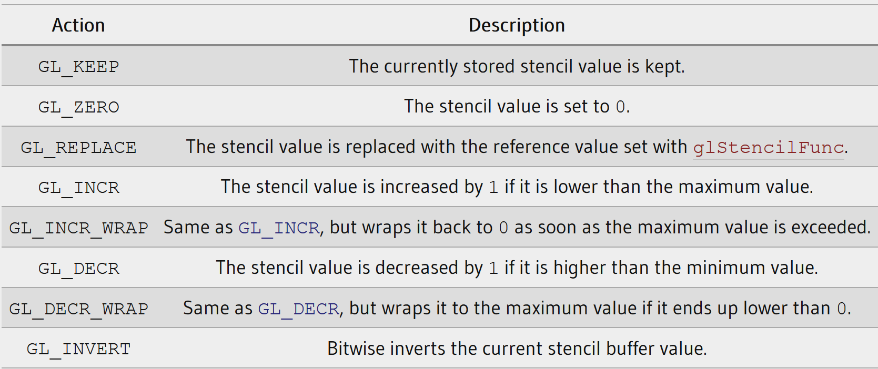
The glStencilOp
Then for each of the options you can take any of the following actions:

Slide 17
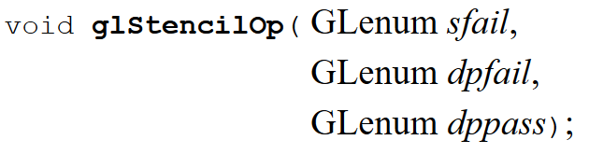
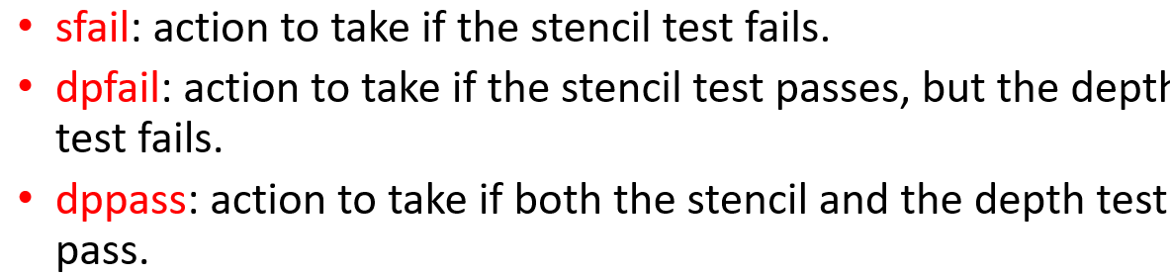
The glStencilOp
By default, the glStencilOp function is set to (GL_KEEP, GL_KEEP, GL_KEEP), so whatever the outcome of any of the tests, the stencil buffer keeps its values.
The default behavior does not update the stencil buffer, so if you want to write to the stencil buffer, you need to specify at least one different action for any of the options.

Slide 18
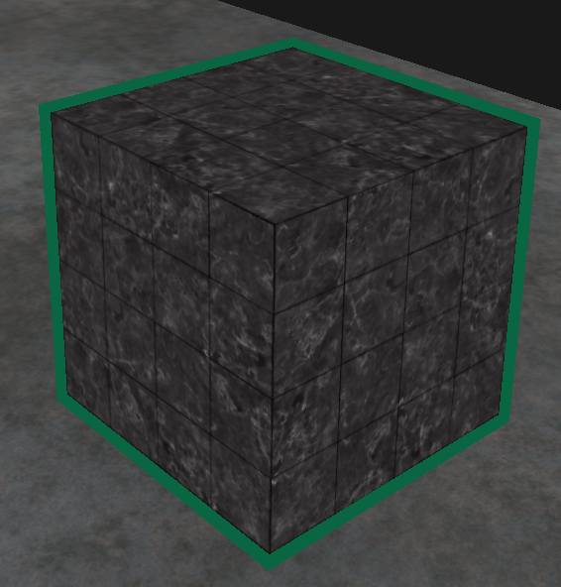
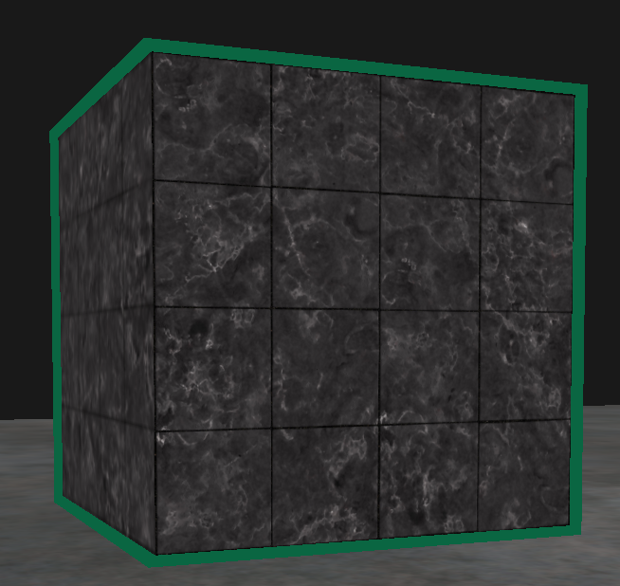
glStencilFunc and glStencilOp
Using glStencilFunc and glStencilOp, we can precisely specify when and how to update the stencil buffer.
Can also specify when the stencil test should pass, e.g., when fragments should be discarded.
We will demonstrate a particularly useful feature that can be implemented with stencil testing called object outlining.

Slide 19
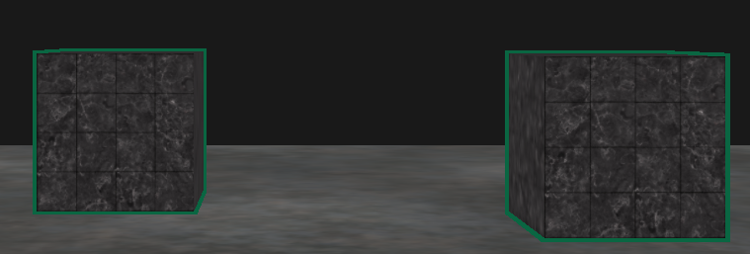
Object Outlining
For each object (or only one), we're creating a small colored border around the (combined) objects.
This is a particular useful effect when you want to select units in a strategy game and need to show the user which of the units were selected.

Slide 20
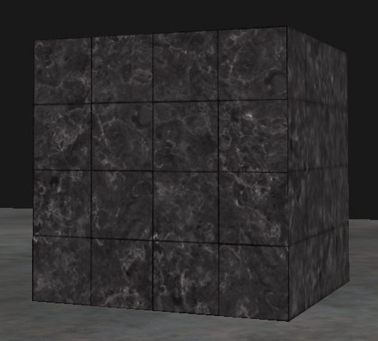
Object Outlining
The routine for outlining your objects is as follows:
Set the stencil func to GL_ALWAYS before drawing the (to be outlined) objects, updating the stencil buffer with 1s wherever the objects' fragments are rendered.
Render the objects.
Disable stencil writing and depth testing.
Scale each of the objects by a small amount.
Use a different fragment shader that outputs a single (border) color.
Draw the objects again, but only if their fragments' stencil values are not equal to 1.
Enable stencil writing and depth testing again.

Slide 21
Object Outlining
This process sets the content of the stencil buffer to 1s for each of the object's fragments
When we want to draw the borders, we draw scaled-up versions of the objects, and wherever the stencil test passes, the scaled-up version is drawn around the objects’ borders.
We're discarding all the fragments of the scaled-up versions that are part of the original objects' fragments using the stencil buffer.

Slide 22
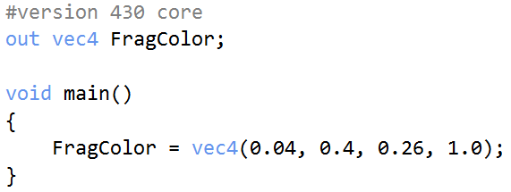
Object Outlining
We're first going to create a very basic fragment shader that outputs a border color.
We simply set a hardcoded color value and call the shader shaderSingleColor:

Slide 23
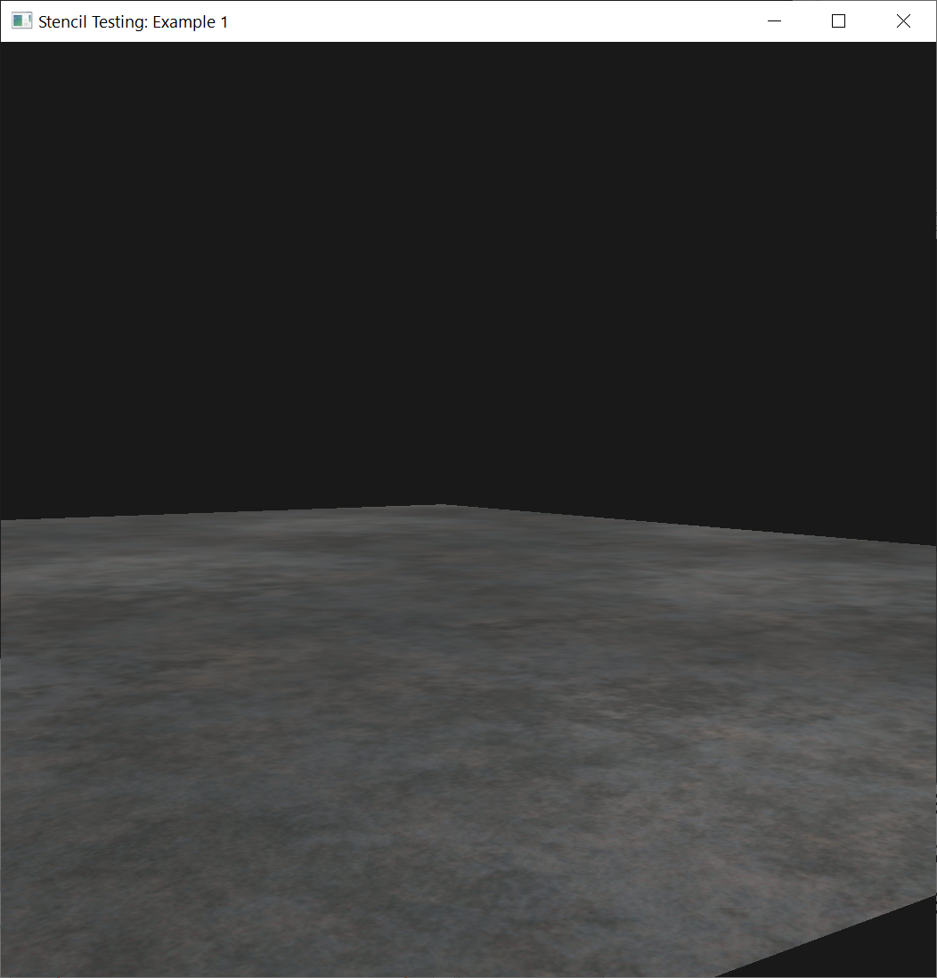
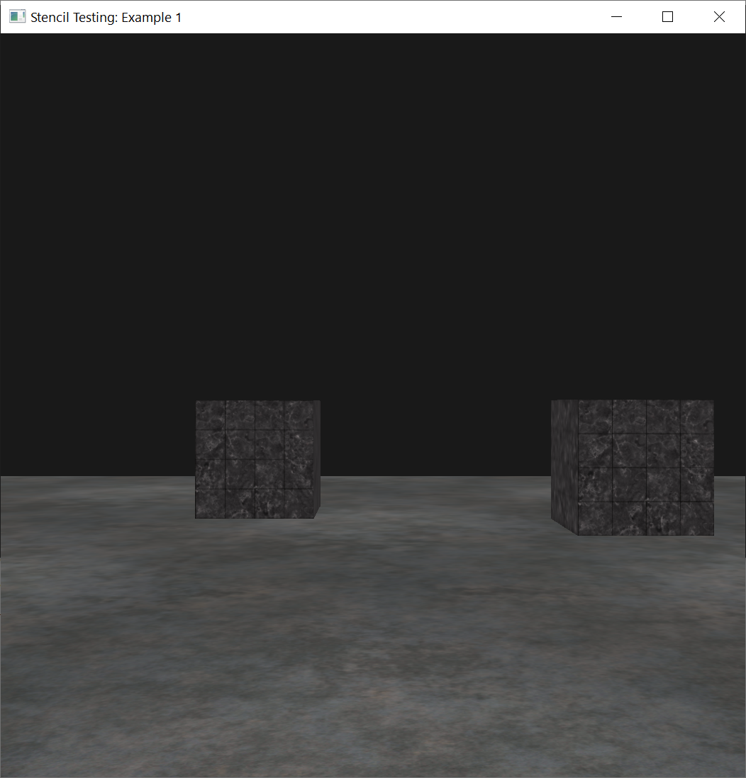
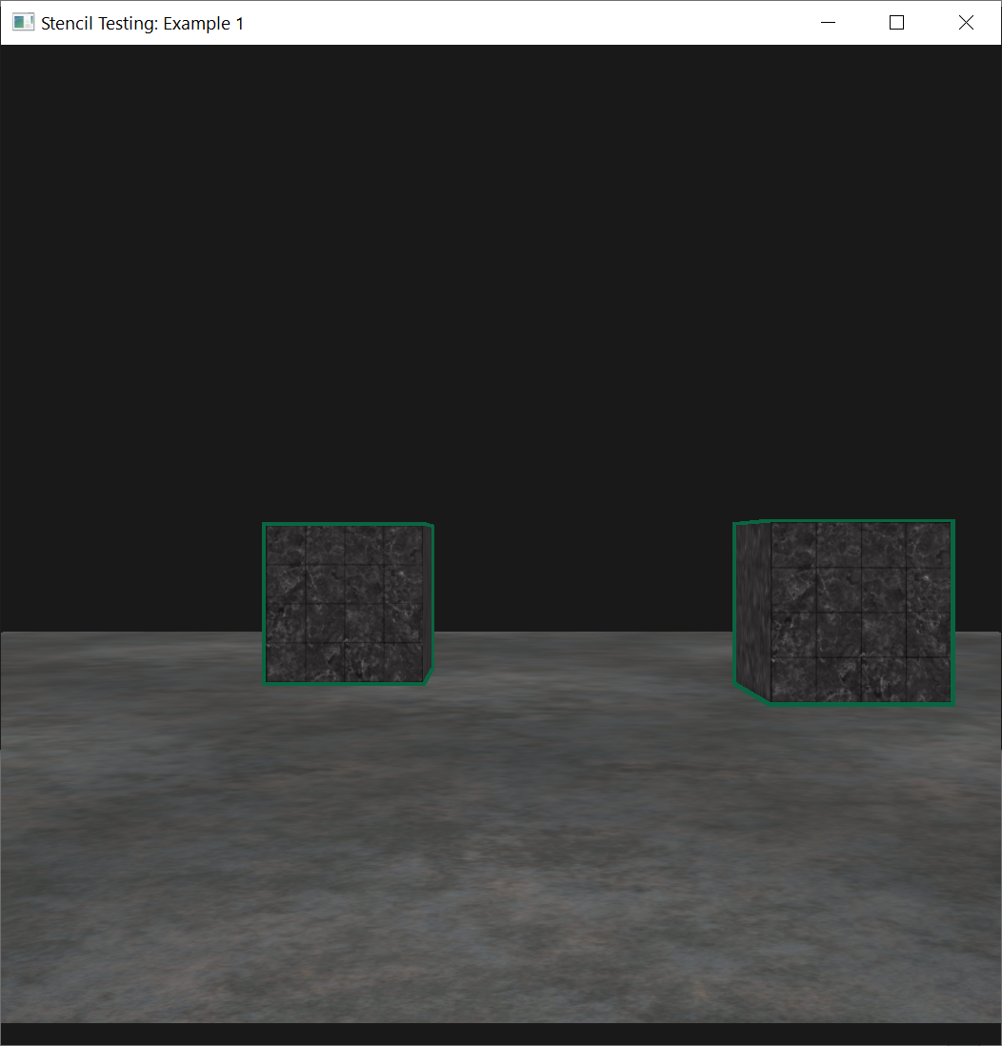
Object Outlining
Going to add object outlining to the two containers and leave the floor out of it.
First draw the floor, then the two containers (while writing to the stencil buffer)
Finally, draw the scaled-up containers (while discarding the fragments that write over the previously drawn container fragments).

Slide 24
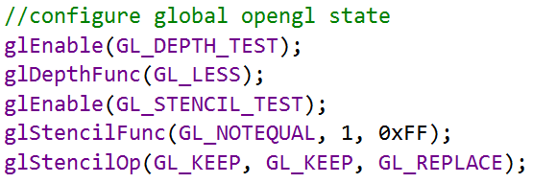
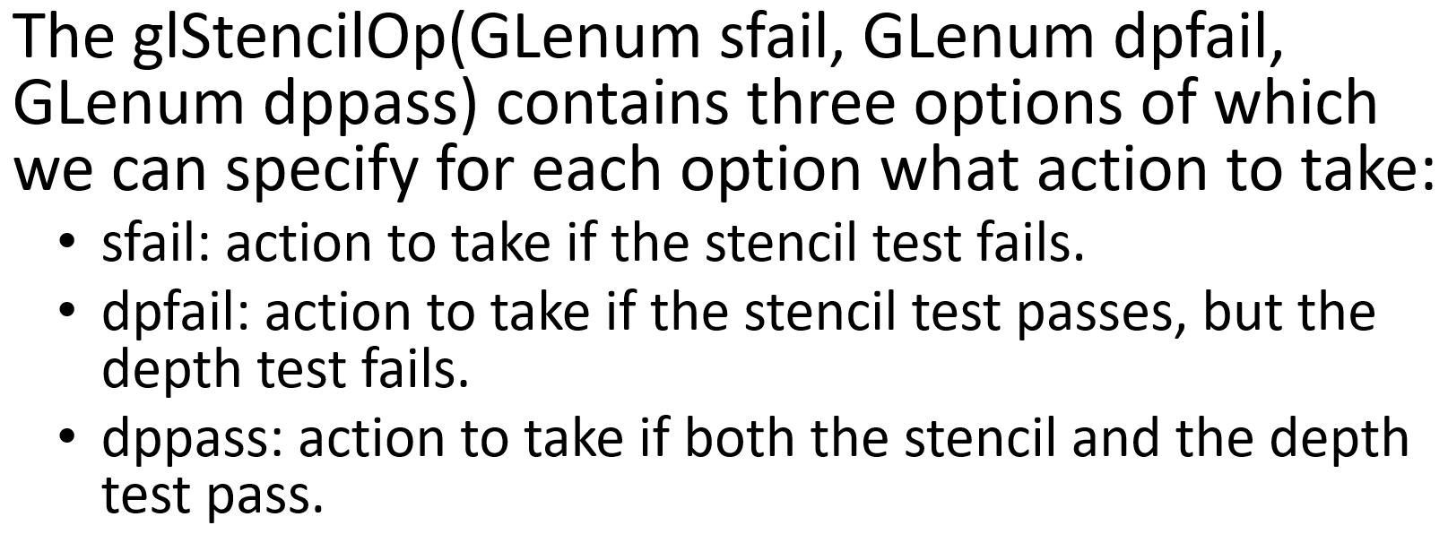
Object Outlining
First, to enable stencil testing and set the actions to take whenever any of the tests succeed or fail:

Slide 25
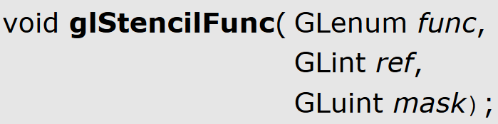
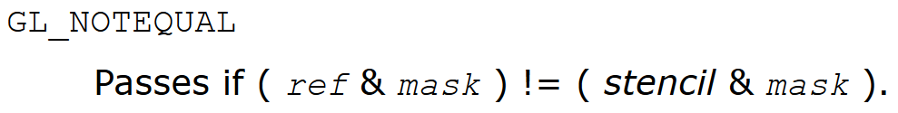
Object Outlining
If any of the tests fail, we do nothing, we simply keep the currently stored value that is in the stencil buffer.
If both the stencil test and the depth test succeed, we replace the stored stencil value with the reference value set via glStencilFunc which we later set to 1.

Slide 26
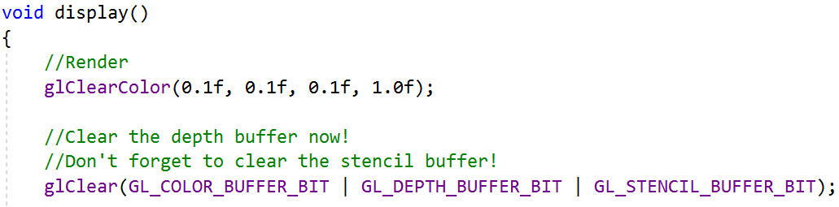
Object Outlining
We clear the stencil buffer to 0s. For the containers, we update the stencil buffer to 1 for each fragment drawn:
Mask: specifies a bit mask to enable and disable writing of individual bits in the stencil planes. Initially, the mask is all 1's.

Slide 27
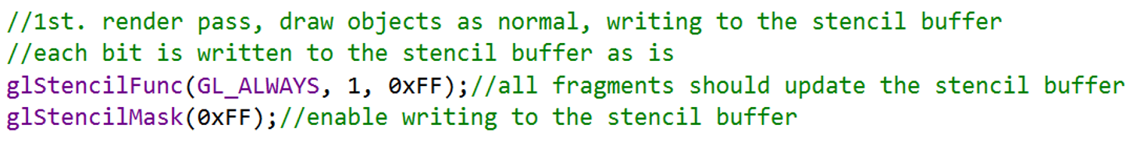
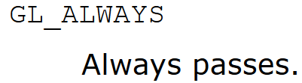
Object Outlining
The GL_ALWAYS stencil testing function is used to ensure that each container’s fragments update the stencil buffer with a stencil value of 1.
Because the fragments always pass the stencil test, the stencil buffer is updated with the reference value wherever we've drawn them.
Mask: specifies a bit mask to enable and disable writing of individual bits in the stencil planes. Initially, the mask is all 1's.

Slide 28
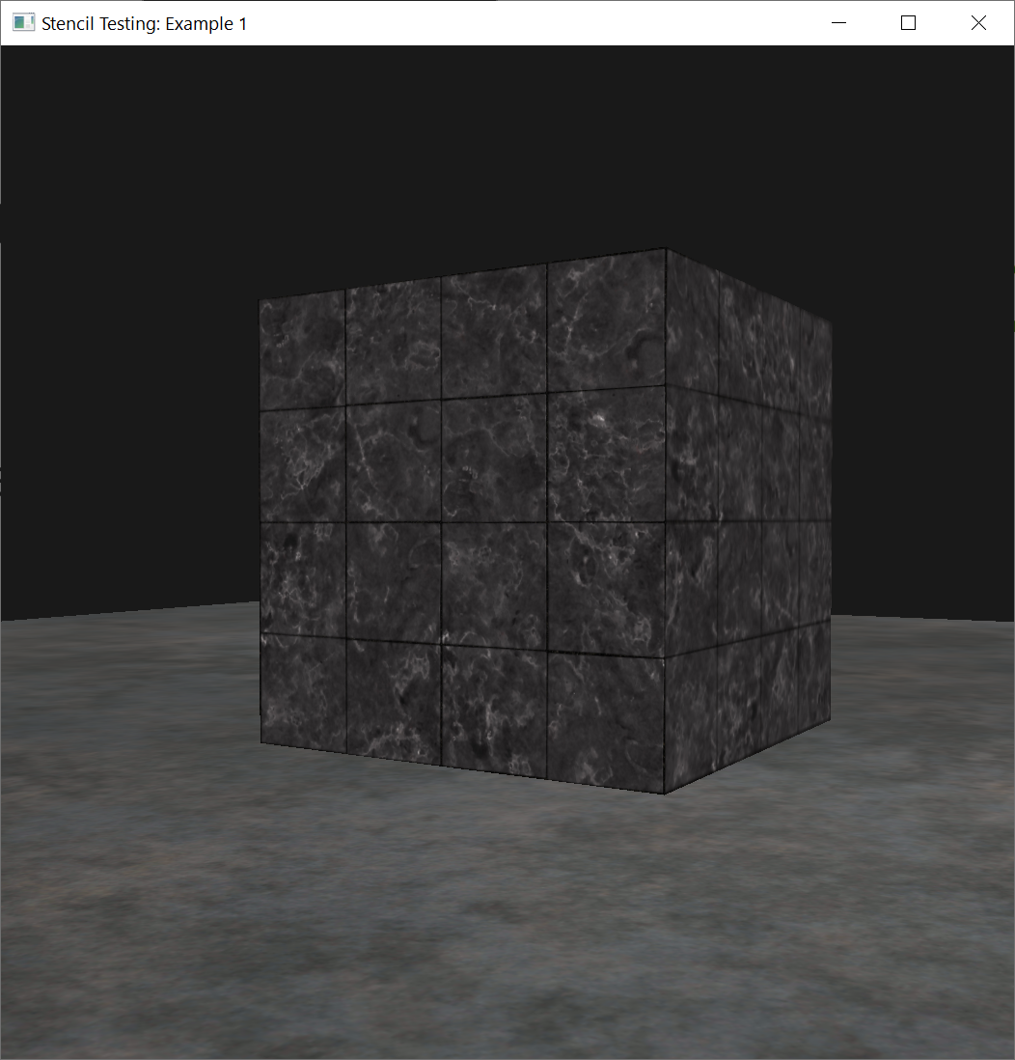
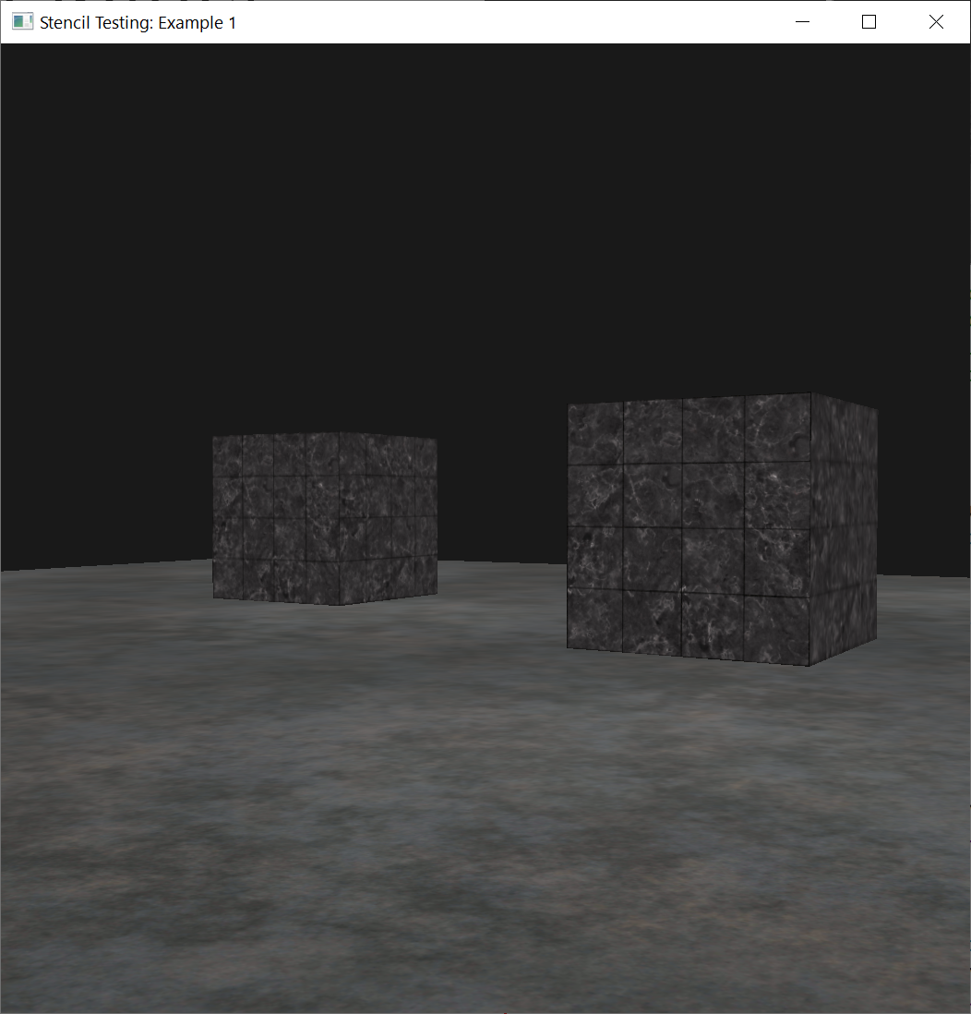
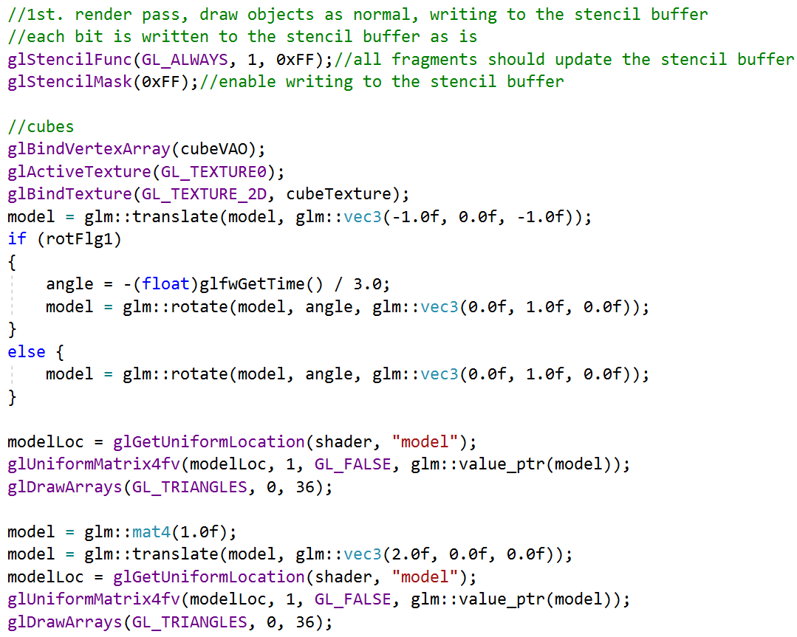
Object Outlining
Now the stencil buffer is updated with 1s, where the containers were drawn

Slide 29
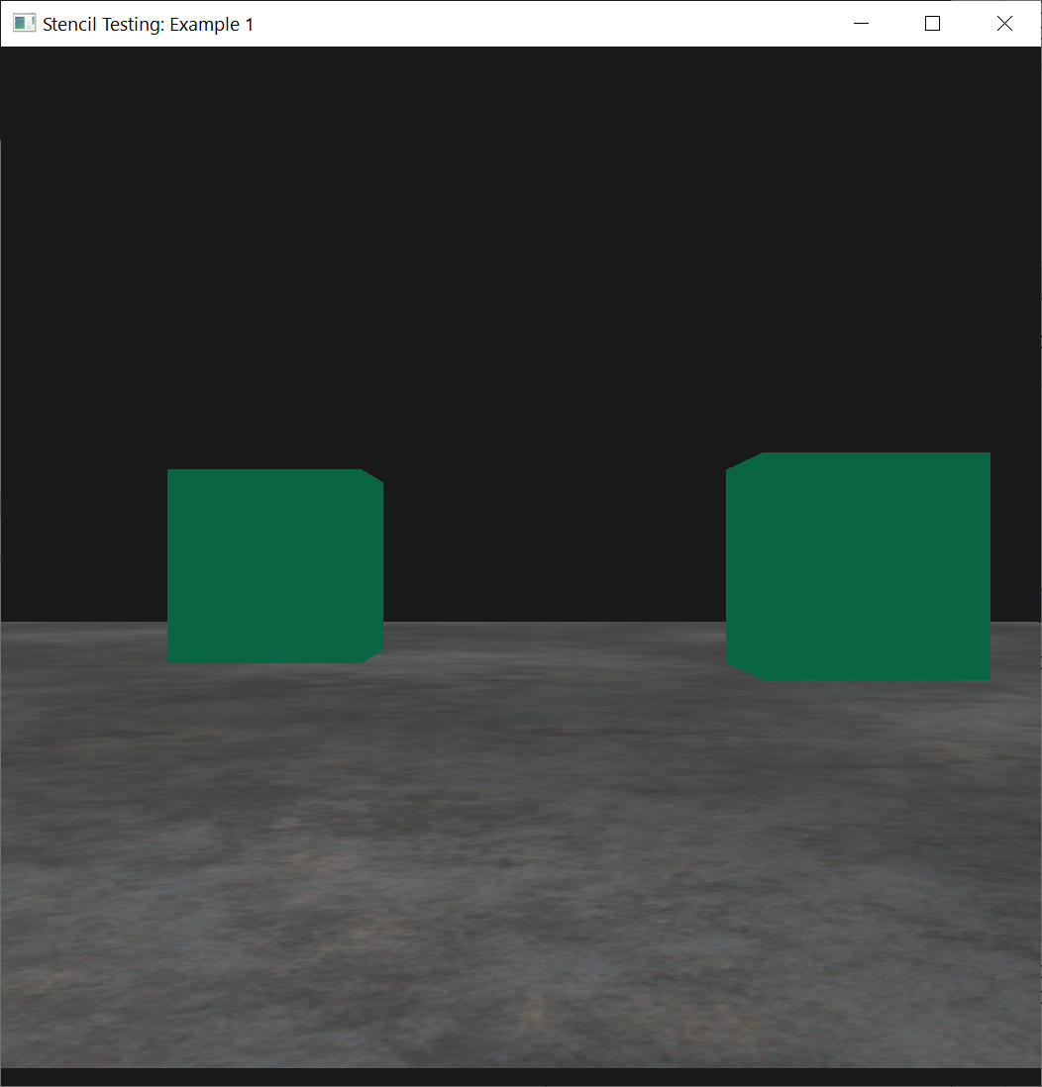
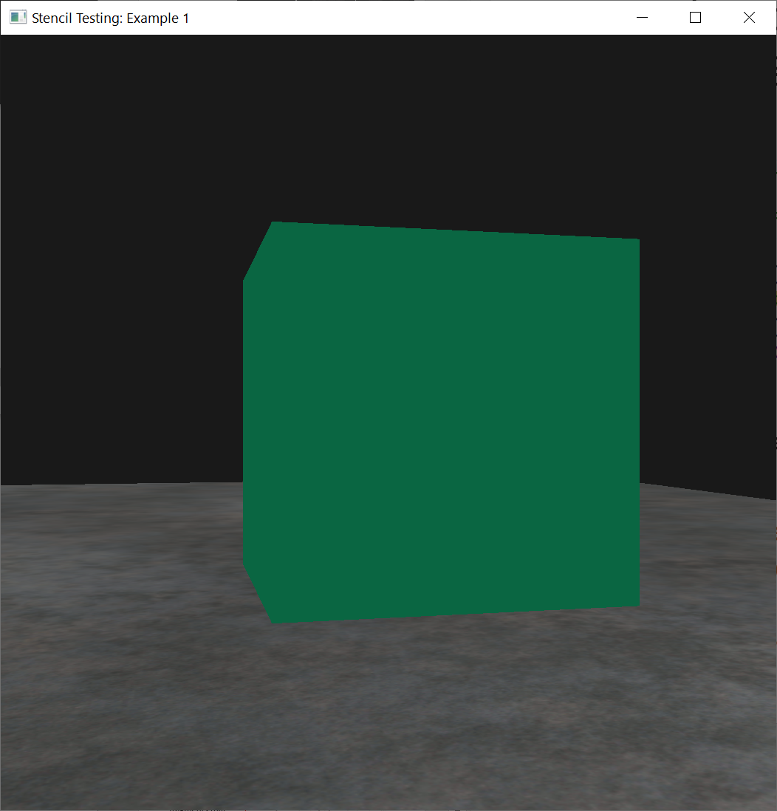
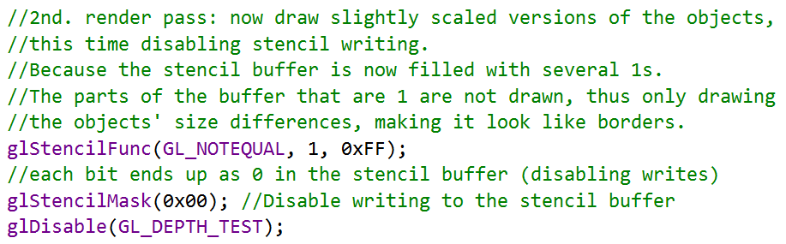
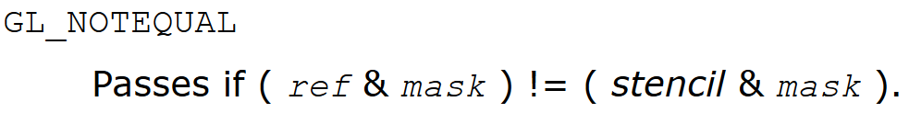
Object Outlining
We're going to draw the upscaled containers, but this time disabling writes to the stencil buffer
Mask: specifies a bit mask to enable and disable writing of individual bits in the stencil planes. Initially, the mask is all 1's.

Slide 30
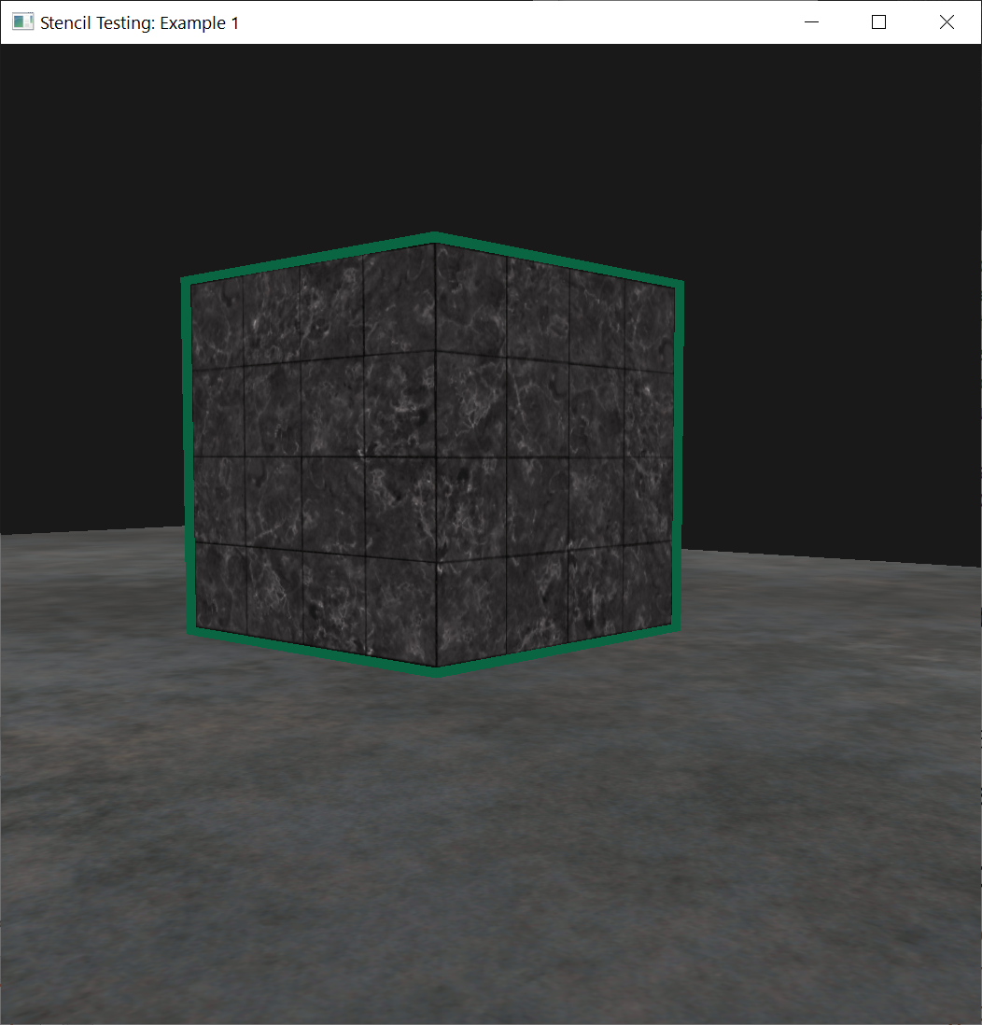
Object Outlining
Set the stencil function to GL_NOTEQUAL, making sure that we're only drawing parts of the containers that are not equal to 1
Thus, only draw the part of the containers that are outside the previously drawn containers.
Also disable depth testing, so the scaled-up containers e.g., the borders do not get overwritten by the floor.
Mask: specifies a bit mask to enable and disable writing of individual bits in the stencil planes. Initially, the mask is all 1's.

Slide 31
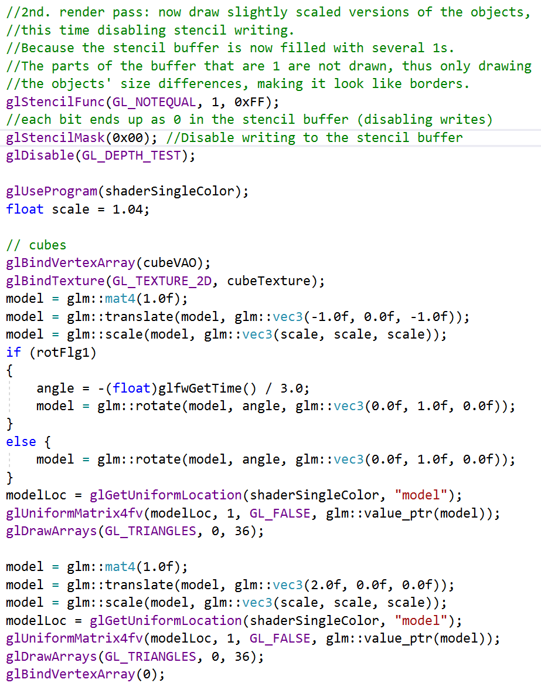
Object Outlining
Draw the upscaled containers
Discard the fragments that write over the previously drawn container fragments

Slide 32
Object Outlining
After drawing the upscaled containers
Make sure to enable the depth buffer again
Enable writing to the stencil buffer

Slide 33
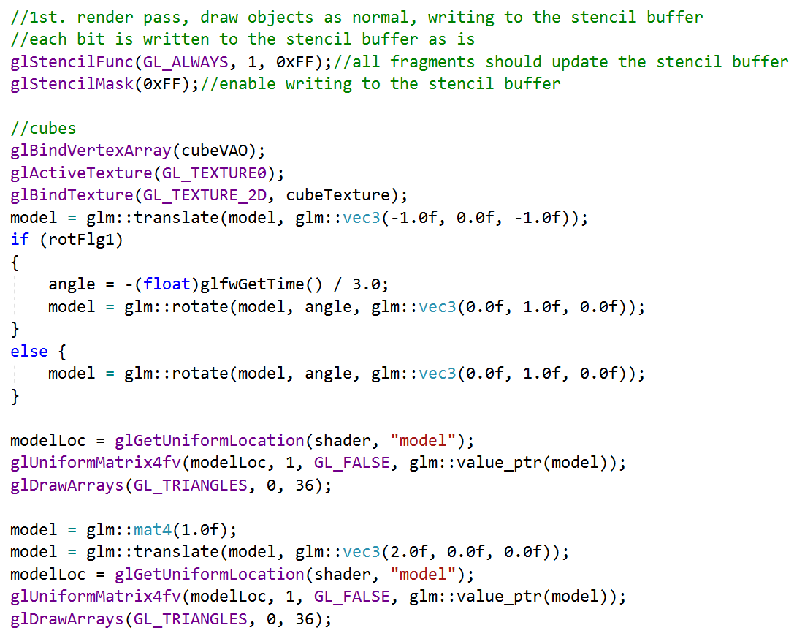
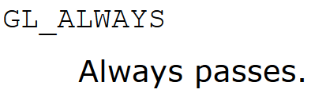
Object Outlining
By using the GL_ALWAYS stencil testing function, we make sure that each of the containers' fragments update the stencil buffer with a stencil value of 1.
Because the fragments always pass the stencil test, the stencil buffer is updated with the reference value wherever we've drawn them.

Slide 34
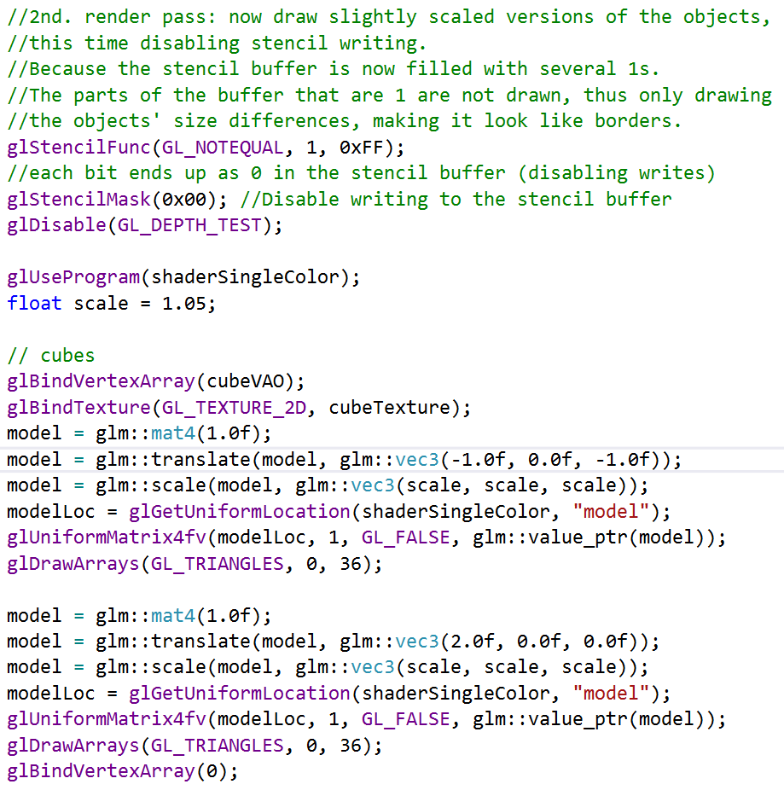
Object Outlining
Now that the stencil buffer is updated with 1s, where the containers were drawn
We're going to draw the upscaled containers, but this time disabling writes to the stencil buffer

Slide 35
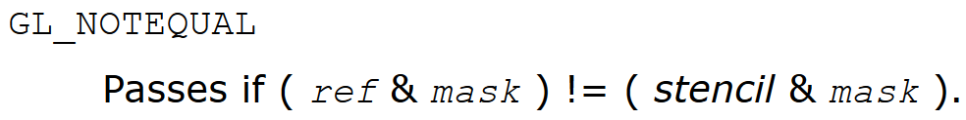
Object Outlining
We set the stencil function to GL_NOTEQUAL, which makes sure that we're only drawing parts of the containers that are not equal to 1
Thus only draw the part of the containers that are outside the previously drawn containers.
Also disable depth testing, so the scaled-up containers e.g. the borders do not get overwritten by the floor.

Slide 36
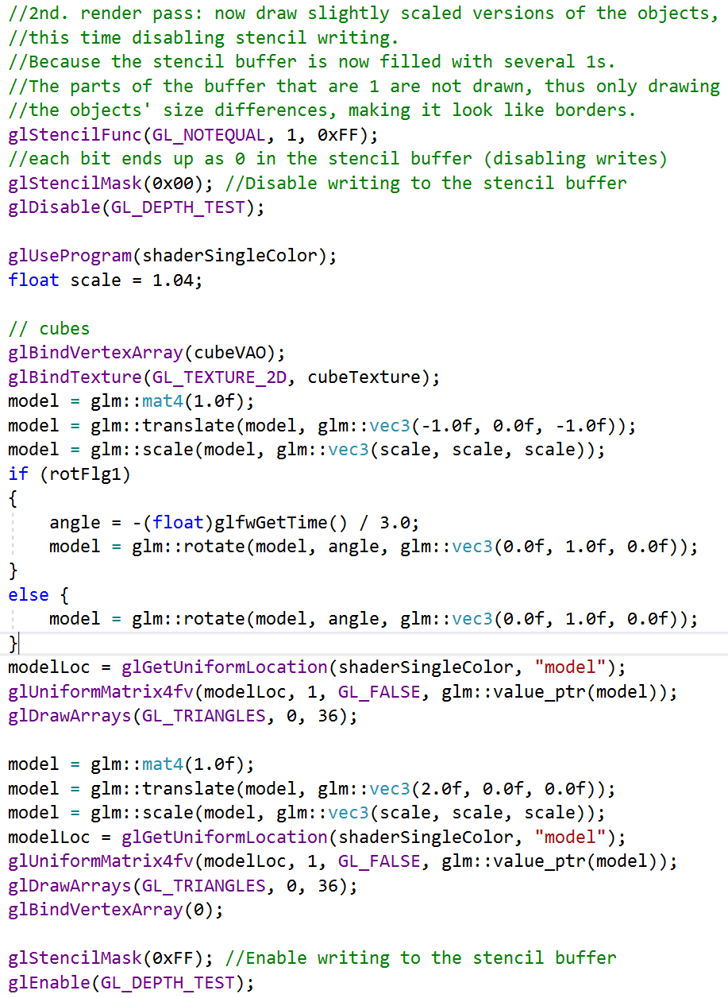
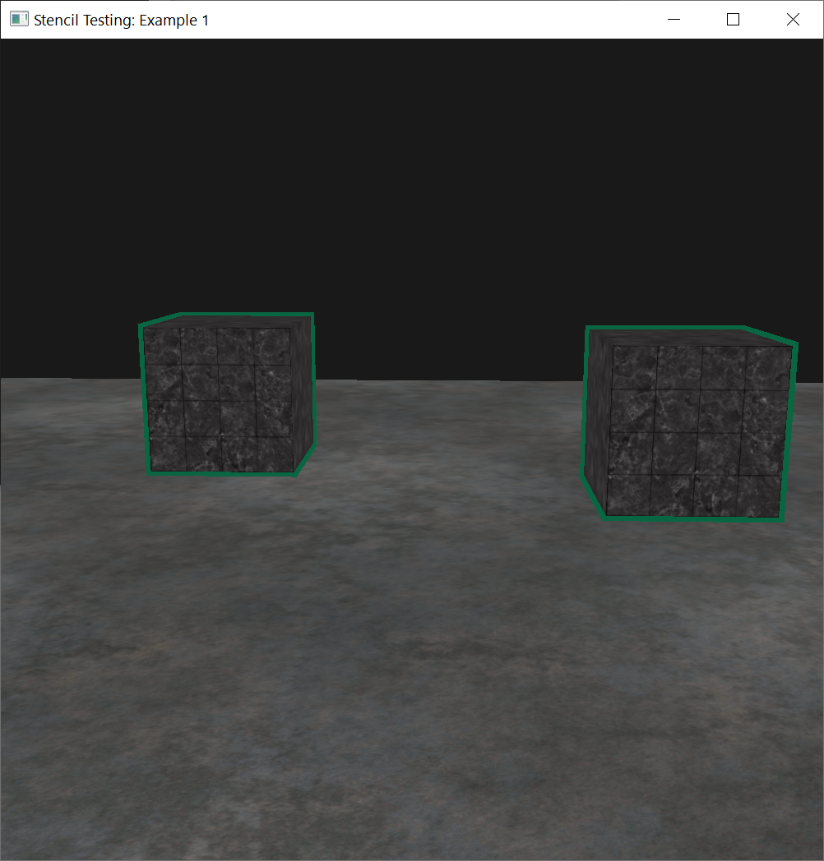
Object Outlining
Make sure to enable the depth buffer again once you're done.
The object outlining rendering result:

Slide 37
Configure Global OpenGL State
//configure global opengl state
glEnable(GL_DEPTH_TEST);
glDepthFunc(GL_LESS);
glEnable(GL_STENCIL_TEST);
glStencilFunc(GL_NOTEQUAL, 1, 0xFF);
glStencilOp(GL_KEEP, GL_KEEP, GL_REPLACE);

Slide 38
Return Shader Program Id
//Return shaderProgram, which is used to set the shader program's ID
shader = loadShader("../../src/shader/2.stencil_testing.vert", "../../src/shader/2.stencil_testing.frag");
shaderSingleColor = loadShader("../../src/shader/2.stencil_testing.vert", "../../src/shader/2.stencil_single_color.frag");

Slide 39
Vertex Shader: 2.stencil_testing.vert
#version 460 core
layout (location = 0) in vec3 aPos;
layout (location = 1) in vec2 aTexCoords;
out vec2 TexCoords;
uniform mat4 model;
uniform mat4 view;
uniform mat4 projection;
void main()
{
TexCoords = aTexCoords;
gl_Position = projection * view * model * vec4(aPos, 1.0f);
}

Slide 40
Fragment Shader: 2.stencil_testing.frag
#version 460 core
out vec4 FragColor;
in vec2 TexCoords;
uniform sampler2D texture1;
void main()
{
FragColor = texture(texture1, TexCoords);
}

Slide 41
Fragment Shader: 2.stencil_single_color.frag
#version 460 core
out vec4 FragColor;
void main()
{
FragColor = vec4(0.04, 0.4, 0.26, 1.0);
}

Slide 42
Set Up Vertex Data for Cube
//Set up vertex data (and buffer(s)) and configure vertex attributes
//Set up vertex data for cube
float cubeVertices[] = {
// positions // texture Coords
-0.5f, -0.5f, -0.5f, 0.0f, 0.0f,
0.5f, -0.5f, -0.5f, 1.0f, 0.0f,
0.5f, 0.5f, -0.5f, 1.0f, 1.0f,
0.5f, 0.5f, -0.5f, 1.0f, 1.0f,
-0.5f, 0.5f, -0.5f, 0.0f, 1.0f,
-0.5f, -0.5f, -0.5f, 0.0f, 0.0f,
-0.5f, -0.5f, 0.5f, 0.0f, 0.0f,
0.5f, -0.5f, 0.5f, 1.0f, 0.0f,
0.5f, 0.5f, 0.5f, 1.0f, 1.0f,
0.5f, 0.5f, 0.5f, 1.0f, 1.0f,
-0.5f, 0.5f, 0.5f, 0.0f, 1.0f,
-0.5f, -0.5f, 0.5f, 0.0f, 0.0f,
-0.5f, 0.5f, 0.5f, 1.0f, 0.0f,
-0.5f, 0.5f, -0.5f, 1.0f, 1.0f,
-0.5f, -0.5f, -0.5f, 0.0f, 1.0f,
-0.5f, -0.5f, -0.5f, 0.0f, 1.0f,
-0.5f, -0.5f, 0.5f, 0.0f, 0.0f,
-0.5f, 0.5f, 0.5f, 1.0f, 0.0f,
0.5f, 0.5f, 0.5f, 1.0f, 0.0f,
0.5f, 0.5f, -0.5f, 1.0f, 1.0f,
0.5f, -0.5f, -0.5f, 0.0f, 1.0f,
0.5f, -0.5f, -0.5f, 0.0f, 1.0f,
0.5f, -0.5f, 0.5f, 0.0f, 0.0f,
0.5f, 0.5f, 0.5f, 1.0f, 0.0f,
-0.5f, -0.5f, -0.5f, 0.0f, 1.0f,
0.5f, -0.5f, -0.5f, 1.0f, 1.0f,
0.5f, -0.5f, 0.5f, 1.0f, 0.0f,
0.5f, -0.5f, 0.5f, 1.0f, 0.0f,
-0.5f, -0.5f, 0.5f, 0.0f, 0.0f,
-0.5f, -0.5f, -0.5f, 0.0f, 1.0f,
-0.5f, 0.5f, -0.5f, 0.0f, 1.0f,
0.5f, 0.5f, -0.5f, 1.0f, 1.0f,
0.5f, 0.5f, 0.5f, 1.0f, 0.0f,
0.5f, 0.5f, 0.5f, 1.0f, 0.0f,
-0.5f, 0.5f, 0.5f, 0.0f, 0.0f,
-0.5f, 0.5f, -0.5f, 0.0f, 1.0f
};

Slide 43
Set Up Vertex Data for Plane
//Set up vertex data for plane
float planeVertices[] = {
// positions // texture Coords
//(note we set these higher than 1 (together with GL_REPEAT as texture wrapping mode).
//this will cause the floor texture to repeat)
5.0f, -0.5f, 5.0f, 2.0f, 0.0f,
-5.0f, -0.5f, 5.0f, 0.0f, 0.0f,
-5.0f, -0.5f, -5.0f, 0.0f, 2.0f,
5.0f, -0.5f, 5.0f, 2.0f, 0.0f,
-5.0f, -0.5f, -5.0f, 0.0f, 2.0f,
5.0f, -0.5f, -5.0f, 2.0f, 2.0f
};

Slide 44
Setting Cube VAO and VBO
//Setting Cube VAO and VBO
glGenVertexArrays(1, &cubeVAO);
glGenBuffers(1, &cubeVBO);
glBindVertexArray(cubeVAO);
glBindBuffer(GL_ARRAY_BUFFER, cubeVBO);
glBufferData(GL_ARRAY_BUFFER, sizeof(cubeVertices), &cubeVertices, GL_STATIC_DRAW);
glEnableVertexAttribArray(0);
glVertexAttribPointer(0, 3, GL_FLOAT, GL_FALSE, 5 * sizeof(float), (void*)0);
glEnableVertexAttribArray(1);
glVertexAttribPointer(1, 2, GL_FLOAT, GL_FALSE, 5 * sizeof(float), (void*)(3 * sizeof(float)));
glBindVertexArray(0);

Slide 45
Setting Plane VAO and VBO
//Setting Plane VAO and VBO
glGenVertexArrays(1, &planeVAO);
glGenBuffers(1, &planeVBO);
glBindVertexArray(planeVAO);
glBindBuffer(GL_ARRAY_BUFFER, planeVBO);
glBufferData(GL_ARRAY_BUFFER, sizeof(planeVertices), &planeVertices, GL_STATIC_DRAW);
glEnableVertexAttribArray(0);
glVertexAttribPointer(0, 3, GL_FLOAT, GL_FALSE, 5 * sizeof(float), (void*)0);
glEnableVertexAttribArray(1);
glVertexAttribPointer(1, 2, GL_FLOAT, GL_FALSE, 5 * sizeof(float), (void*)(3 * sizeof(float)));
glBindVertexArray(0);

Slide 46
Load Texture
//Load textures
cubeTexture = loadTexture("../../src/resources/textures/marble.jpg");
floorTexture = loadTexture("../../src/resources/textures/metal.png");

Slide 47
Clear Depth Buffer and Stencil Buffer
//Clear Depth buffer and stencil buffer
//Clear the depth buffer now!
//Remember to clear the stencil buffer!
glClear(GL_COLOR_BUFFER_BIT | GL_DEPTH_BUFFER_BIT | GL_STENCIL_BUFFER_BIT);

Slide 48
Active Shader: Using shaderSingleColor
//Activate shader: using shaderSingleColor
//be sure to activate shader when setting uniforms/drawing objects
glUseProgram(shaderSingleColor);
glm::mat4 model = glm::mat4(1.0f);
glm::mat4 view = camera.GetViewMatrix();
glm::mat4 projection = glm::perspective(glm::radians(camera.Zoom), (float)SCR_WIDTH / (float)SCR_HEIGHT, 0.1f, 100.0f);
unsigned int viewLoc = glGetUniformLocation(shaderSingleColor, "view");
glUniformMatrix4fv(viewLoc, 1, GL_FALSE, glm::value_ptr(view));
unsigned int projectionLoc = glGetUniformLocation(shaderSingleColor, "projection");
glUniformMatrix4fv(projectionLoc, 1, GL_FALSE, glm::value_ptr(projection));

Slide 49
Active Shader: Using shader
//Activate shader: using shader
glUseProgram(shader);
viewLoc = glGetUniformLocation(shader, "view");
glUniformMatrix4fv(viewLoc, 1, GL_FALSE, glm::value_ptr(view));
projectionLoc = glGetUniformLocation(shader, "projection");
glUniformMatrix4fv(projectionLoc, 1, GL_FALSE, glm::value_ptr(projection));

Slide 50
Draw Floor as Normal
We set the floor mask to 0x00 to not write to the stencil buffer
//draw the floor as normal, but don't write the floor to the stencil buffer,
//we only care about the containers. We set its mask to 0x00 to not write to the
//stencil buffer.
glStencilMask(0x00);
//floor
glBindVertexArray(planeVAO);
glBindTexture(GL_TEXTURE_2D, floorTexture);
model = glm::mat4(1.0f);
unsigned int modelLoc = glGetUniformLocation(shader, "model");
glUniformMatrix4fv(modelLoc, 1, GL_FALSE, glm::value_ptr(model));
glDrawArrays(GL_TRIANGLES, 0, 6);
glBindVertexArray(0);

Slide 51
The Cubes: 1st Render Pass
//The cube: 1st. render pass, draw objects as normal, writing to the stencil buffer
//each bit is written to the stencil buffer as is
glStencilFunc(GL_ALWAYS, 1, 0xFF);//all fragments should update the stencil buffer
glStencilMask(0xFF);//enable writing to the stencil buffer

Slide 52
Drawing Cubes
//Drawing cubes
glBindVertexArray(cubeVAO);
glActiveTexture(GL_TEXTURE0);
glBindTexture(GL_TEXTURE_2D, cubeTexture);
model = glm::translate(model, glm::vec3(-1.0f, 0.0f, -1.0f));
if (rotFlg1)
{
angle = -(float)glfwGetTime() / 3.0;
model = glm::rotate(model, angle, glm::vec3(0.0f, 1.0f, 0.0f));
}
else {
model = glm::rotate(model, angle, glm::vec3(0.0f, 1.0f, 0.0f));
}
modelLoc = glGetUniformLocation(shader, "model");
glUniformMatrix4fv(modelLoc, 1, GL_FALSE, glm::value_ptr(model));
glDrawArrays(GL_TRIANGLES, 0, 36);
model = glm::mat4(1.0f);
model = glm::translate(model, glm::vec3(2.0f, 0.0f, 0.0f));
modelLoc = glGetUniformLocation(shader, "model");
glUniformMatrix4fv(modelLoc, 1, GL_FALSE, glm::value_ptr(model));
glDrawArrays(GL_TRIANGLES, 0, 36);

Slide 53
The Cubes: 2nd Render Pass
//The cubes: 2nd. render pass: now draw slightly scaled versions of the objects,
//This time, disabling stencil writing.
//Because the stencil buffer is now filled with several 1s.
//The parts of the buffer that are 1 are not drawn, thus only drawing
//the objects' size differences, making them look like borders.
glStencilFunc(GL_NOTEQUAL, 1, 0xFF);
//each bit ends up as 0 in the stencil buffer (disabling writes)
glStencilMask(0x00); //Disable writing to the stencil buffer
glDisable(GL_DEPTH_TEST);
glUseProgram(shaderSingleColor);
float scale = 1.04;

Slide 54
Drawing the Cubes
//Drawing the cubes
glBindVertexArray(cubeVAO);
glBindTexture(GL_TEXTURE_2D, cubeTexture);
model = glm::mat4(1.0f);
model = glm::translate(model, glm::vec3(-1.0f, 0.0f, -1.0f));
model = glm::scale(model, glm::vec3(scale, scale, scale));
if (rotFlg1)
{
angle = -(float)glfwGetTime() / 3.0;
model = glm::rotate(model, angle, glm::vec3(0.0f, 1.0f, 0.0f));
}
else {
model = glm::rotate(model, angle, glm::vec3(0.0f, 1.0f, 0.0f));
}
modelLoc = glGetUniformLocation(shaderSingleColor, "model");
glUniformMatrix4fv(modelLoc, 1, GL_FALSE, glm::value_ptr(model));
glDrawArrays(GL_TRIANGLES, 0, 36);
model = glm::mat4(1.0f);
model = glm::translate(model, glm::vec3(2.0f, 0.0f, 0.0f));
model = glm::scale(model, glm::vec3(scale, scale, scale));
modelLoc = glGetUniformLocation(shaderSingleColor, "model");
glUniformMatrix4fv(modelLoc, 1, GL_FALSE, glm::value_ptr(model));
glDrawArrays(GL_TRIANGLES, 0, 36);
glBindVertexArray(0);

Slide 55
Enable Writing to the Stencil Buffer
//Enable writing to the stencil buffer
glStencilMask(0xFF);
glEnable(GL_DEPTH_TEST);

Slide 56
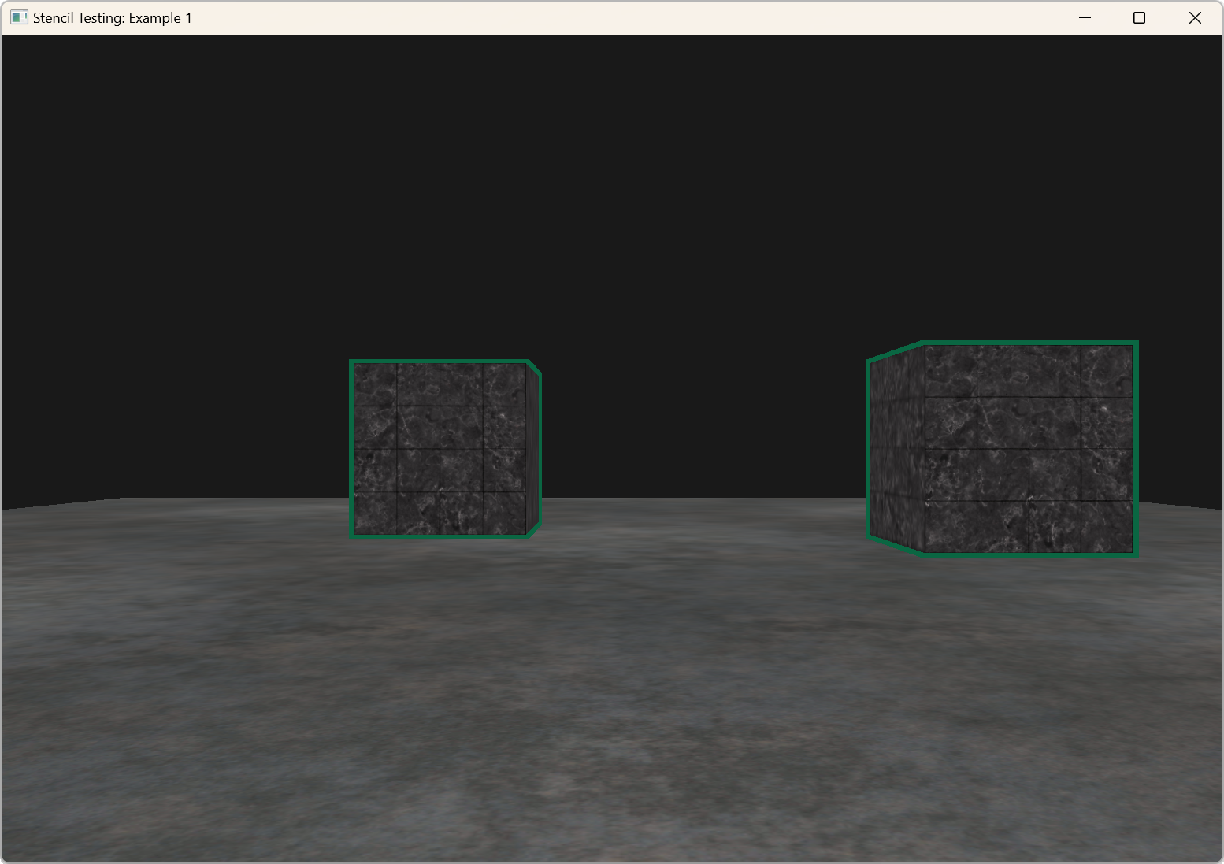
Example 1: Result

Slide 57
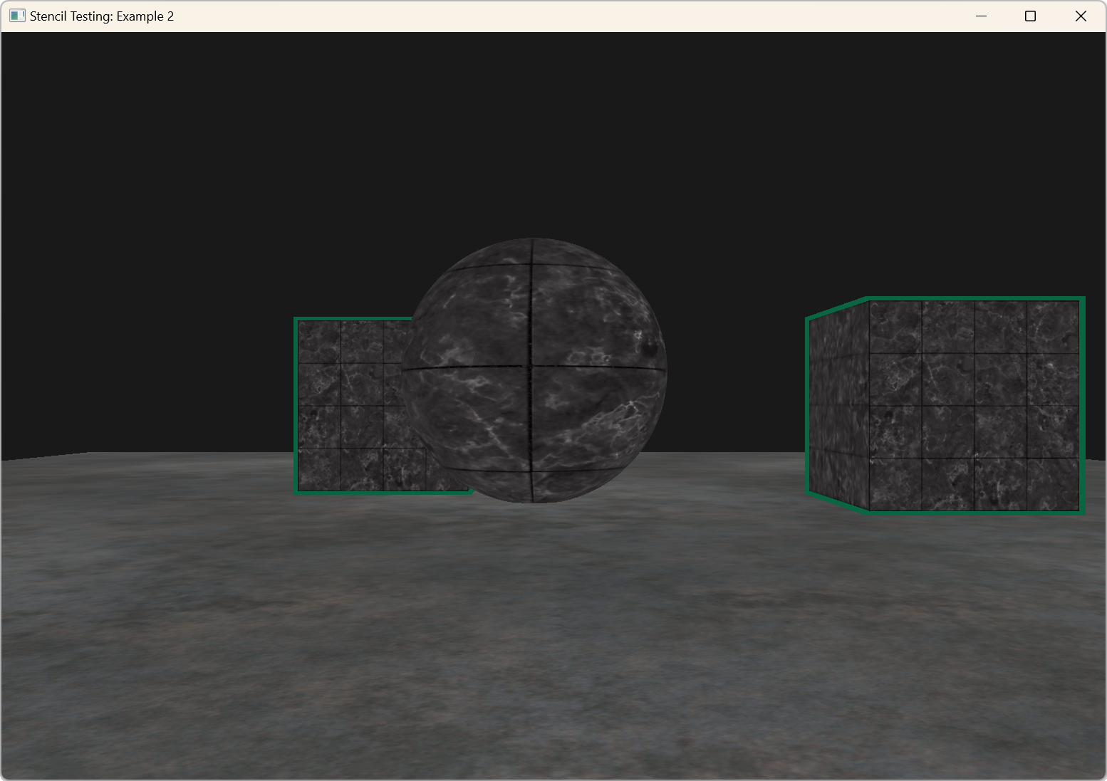
Example 2: Result

Slide 58
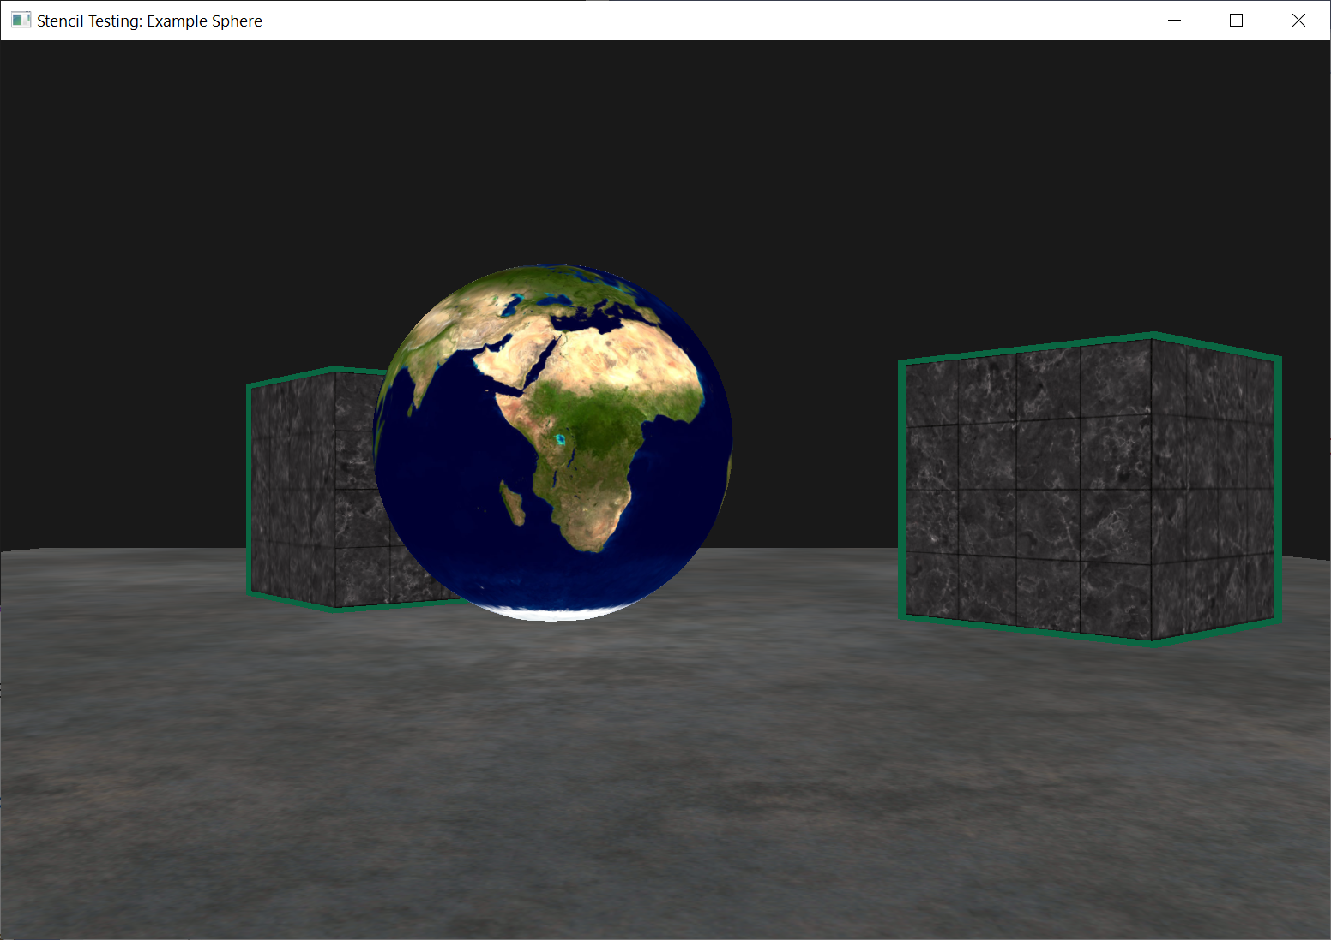
Exercise: Result

